Slide 1
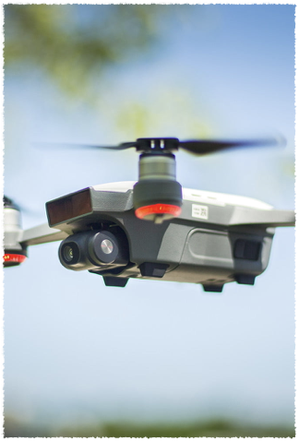
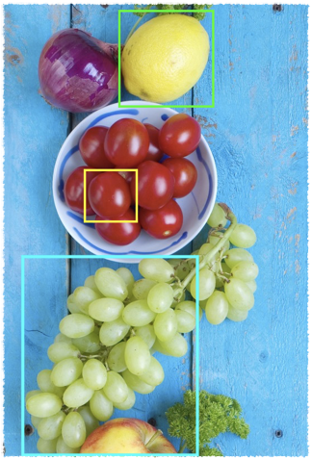
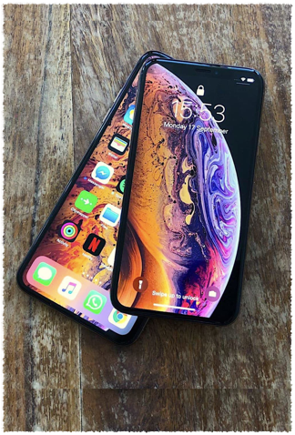
Ag-Drone
Drone Application for farm exploration.

Slide 2
Objective
“A different way of using drone generated data”

Slide 3
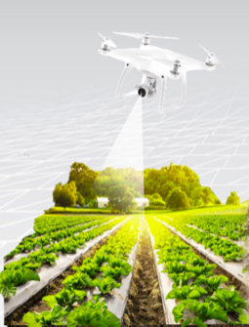
Idea
“Agricultural crops
survey and analyst”

Slide 4
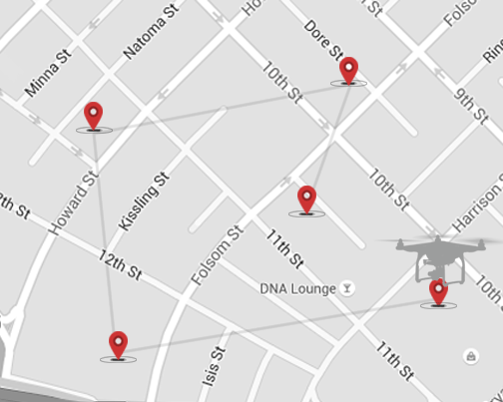
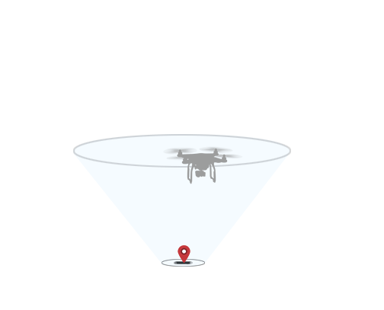
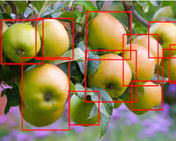
Methods
Mission
Collection
Calculation

Slide 5

Implementation
Mission -> Drone SDK (DJI)
Data Collection -> Drone SDK (DJI)
Object Detection -> ML SDK (OpenCV, Tensorflow, Vision)

Slide 6
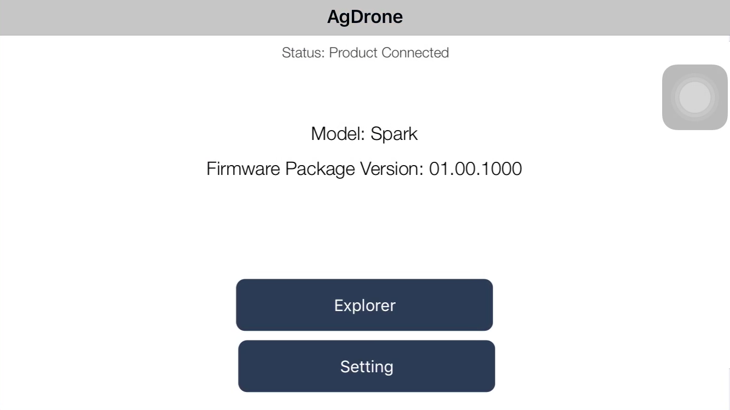
Our Application
DJI + Vision

Slide 7
“Q & A”

Slide 8
“Thank you”
–Team 2 @ WinterHack2019
___________________________________________________
Detchat Boonpragob; Jingyi Wan; Jinzheng Zhao; Imranoor Rahman; Zhan Gao

